Slide 1

Chapter 5 Part 2
Advanced Data Modeling
The slides in this presentation have been adapted from slides provided with the textbook, Database Systems: Design, Implementation, and Management,
12E, Cornel and Morris, Copyright © 2017 Cengage Learning.

Slide 2
Learning Objectives
Create primary keys with proper characteristics
Describe flexible solutions for special data modeling cases
Copyright © 2017 Cengage Learning
2

Slide 3
Entity Integrity: Selecting Primary Keys
Primary key is the most important characteristic of an entity
Single attribute or some combination of attributes
Primary key’s function is to guarantee entity integrity
Primary keys and foreign keys work together to implement relationships
Properly selecting primary key has direct bearing on efficiency and effectiveness
Copyright © 2017 Cengage Learning
3

Slide 4
Natural Keys and Primary Keys
Natural key is a real-world identifier used to uniquely identify real-world objects
Familiar to end users and forms part of their day-to-day business vocabulary
Generally, data modeler uses natural identifier as primary key of entity being modeled
May instead use composite primary key or surrogate key
Copyright © 2017 Cengage Learning
4

Slide 5
Primary Key Guidelines
Attribute that uniquely identifies entity instances in an entity set
Could also be combination of attributes
Main function is to uniquely identify an entity instance or row within a table
Guarantee entity integrity, not to “describe” the entity
Primary keys and foreign keys implement relationships among entities
Placed there by the designer
Behind the scenes, hidden from user
Copyright © 2017 Cengage Learning
5

Slide 6
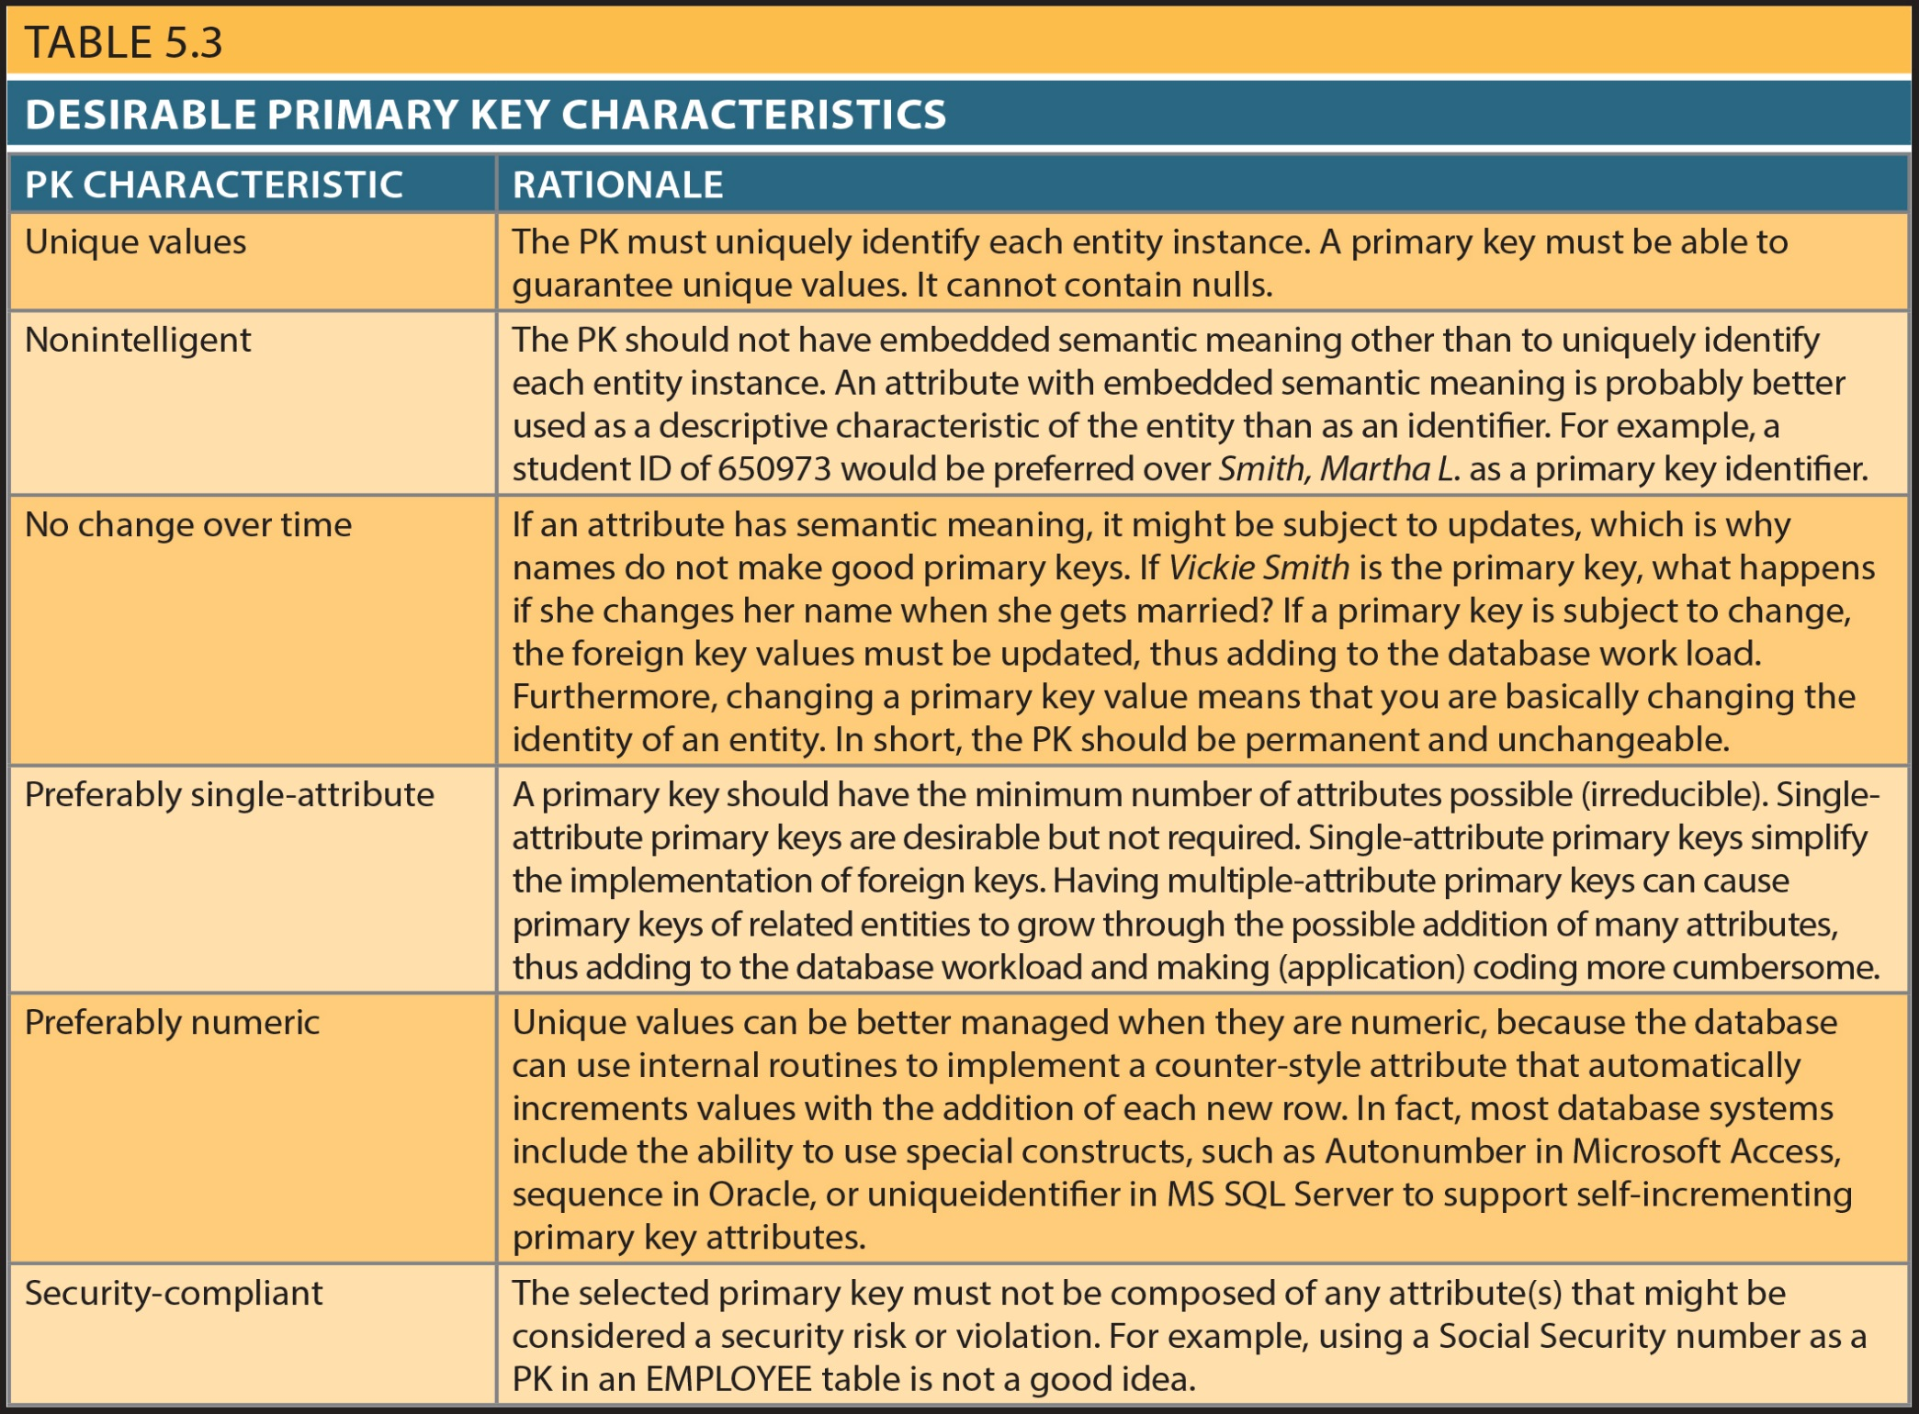
Copyright © 2017 Cengage Learning
6

Slide 7
When to Use Composite Primary Keys
Composite primary keys useful in two cases:
As identifiers of composite entities
In which each primary key combination is allowed once in M:N relationship
As identifiers of weak entities
In which weak entity has a strong identifying relationship with the parent entity
Automatically provides benefit of ensuring that there cannot be duplicate values
Copyright © 2017 Cengage Learning
7

Slide 8
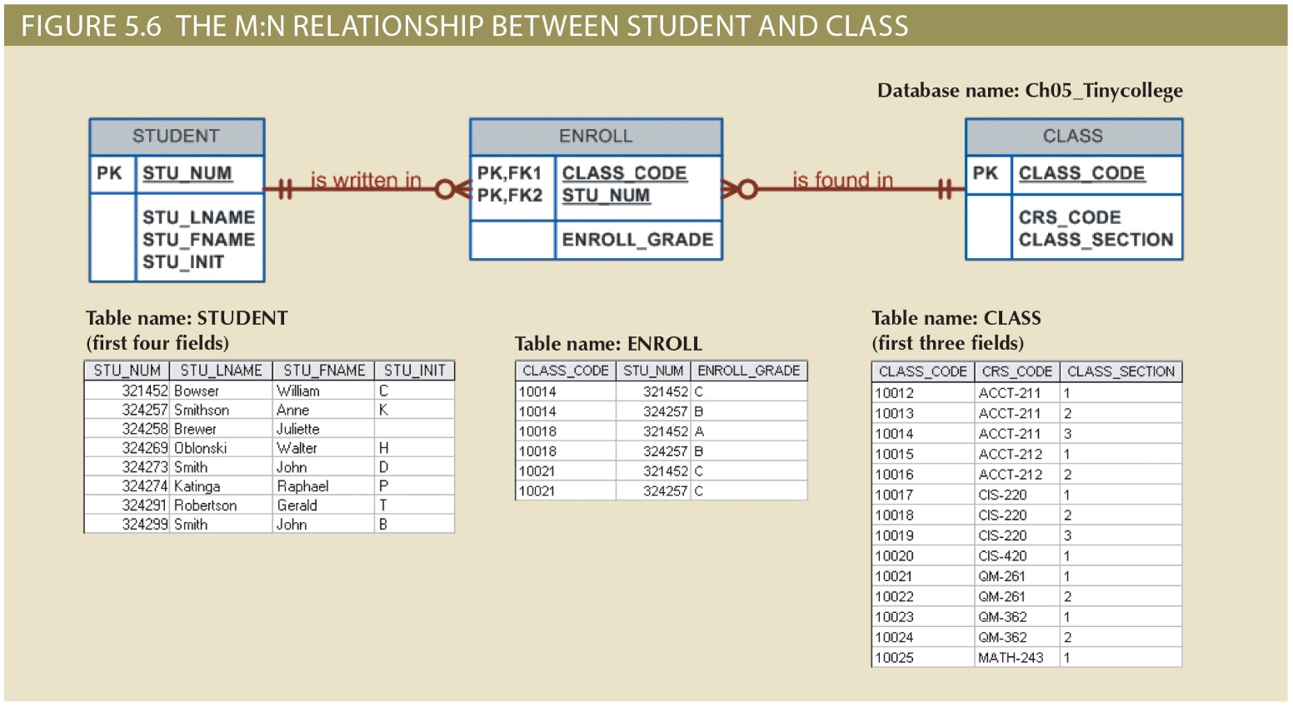
Copyright © 2017 Cengage Learning
8

Slide 9
When to Use Composite Primary Keys(cont’d.)
When used as identifiers of weak entities normally used to represent:
Real-world object that is existent-dependent on another real-world object
Real-world object that is represented in data model as two separate entities in strong identifying relationship
Dependent entity exists only when it is related to independent entity
Copyright © 2017 Cengage Learning
9

Slide 10
When To Use Surrogate Primary Keys
Especially helpful when there is:
No natural key
Selected candidate key has embedded semantic contents
Selected candidate key is too long or cumbersome
If you use surrogate key:
Ensure that end-user candidate key of entity in question performs properly
Use “unique index” and “not null” constraints
Copyright © 2017 Cengage Learning
10

Slide 11
Design Case 1: Implementing 1:1 Relationships
Foreign keys work with primary keys to properly implement relationships in relational model
For 1:M, we put the primary key of the “one” side on the “many” side as foreign key
In 1:1 relationship, there are two options:
Place a foreign key in both entities (not recommended)
Place a foreign key in one of the entities
Primary key of one of the two entities appears as foreign key of other
Copyright © 2017 Cengage Learning
11

Slide 12
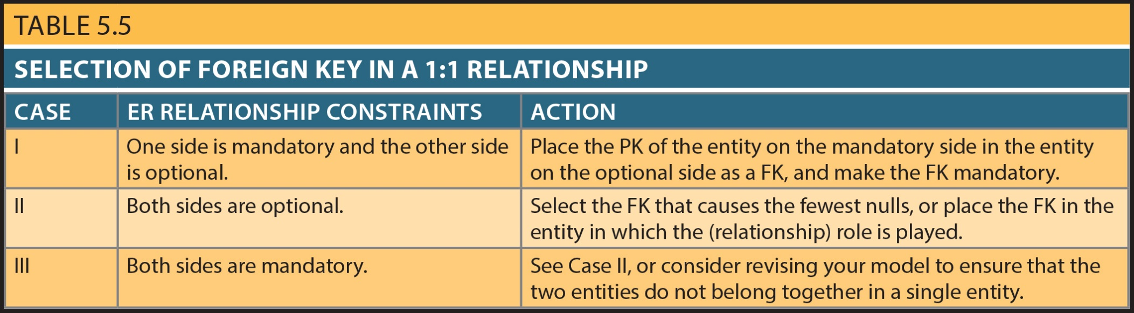
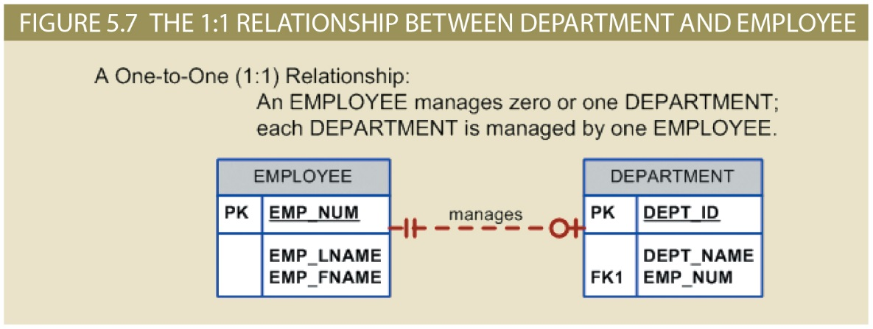
Design Case 1: Implementing 1:1 Relationships
Copyright © 2017 Cengage Learning
12

Slide 13
Design Case 2: Maintaining History of Time-Variant Data
Normally, existing attribute values are replaced with new value without regard to previous value
Time-variant data:
Values change over time
Must keep a history of data changes
Keeping history of time-variant data equivalent to having a multivalued attribute in your entity
Must create new entity and 1:M relationship with original entity
New entity contains new value, date of change
Copyright © 2017 Cengage Learning
13

Slide 14
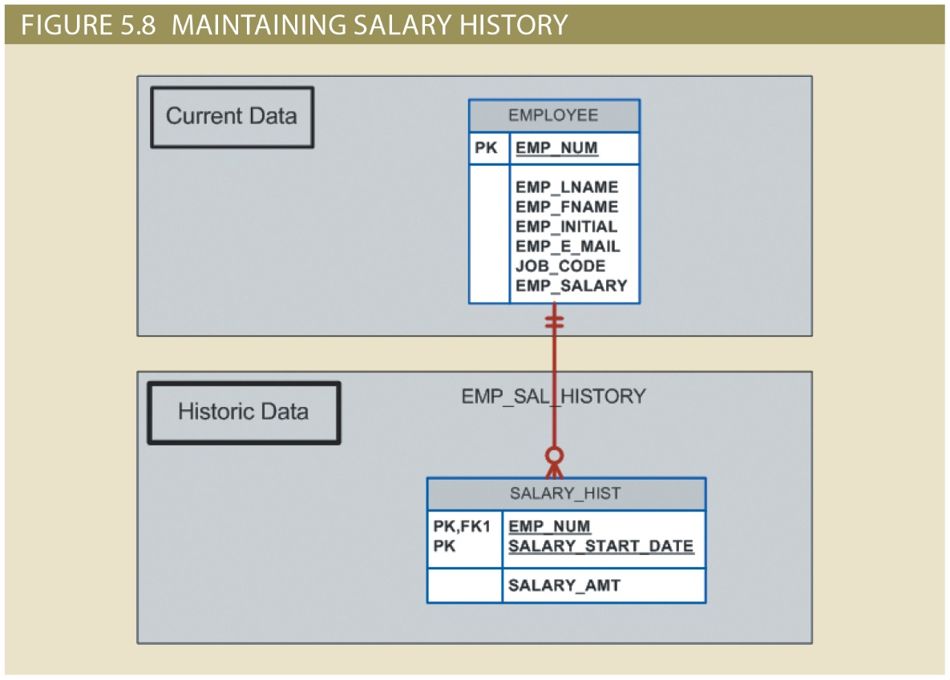
Copyright © 2017 Cengage Learning
14

Slide 15
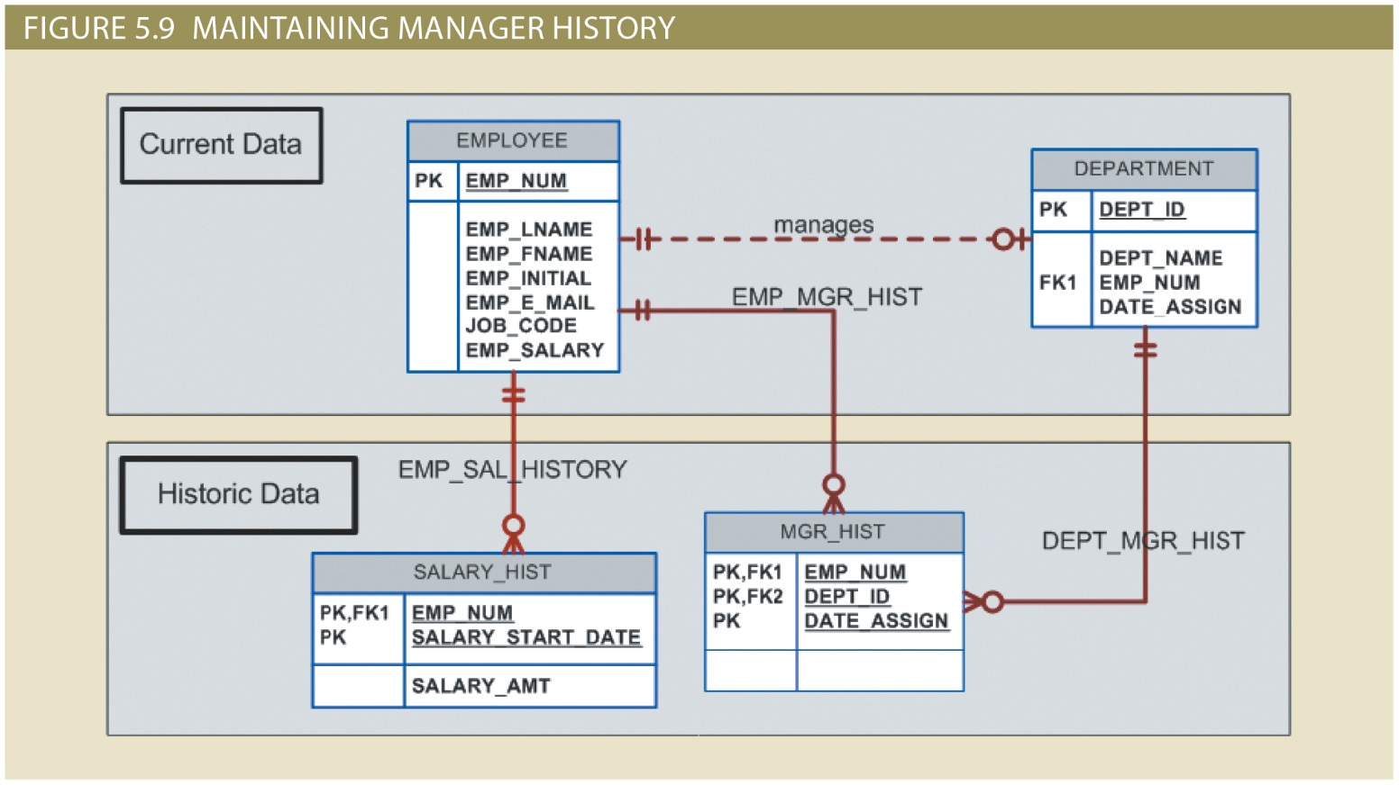
Copyright © 2017 Cengage Learning
15

Slide 16
Design Case 3: Fan Traps
Design trap occurs when relationship is improperly or incompletely identified
Represented in a way not consistent with the real world
Most common design trap is known as fan trap
Fan trap occurs when one entity is in two 1:M relationships to other entities
Produces an association among other entities not expressed in the model
Copyright © 2017 Cengage Learning
16

Slide 17
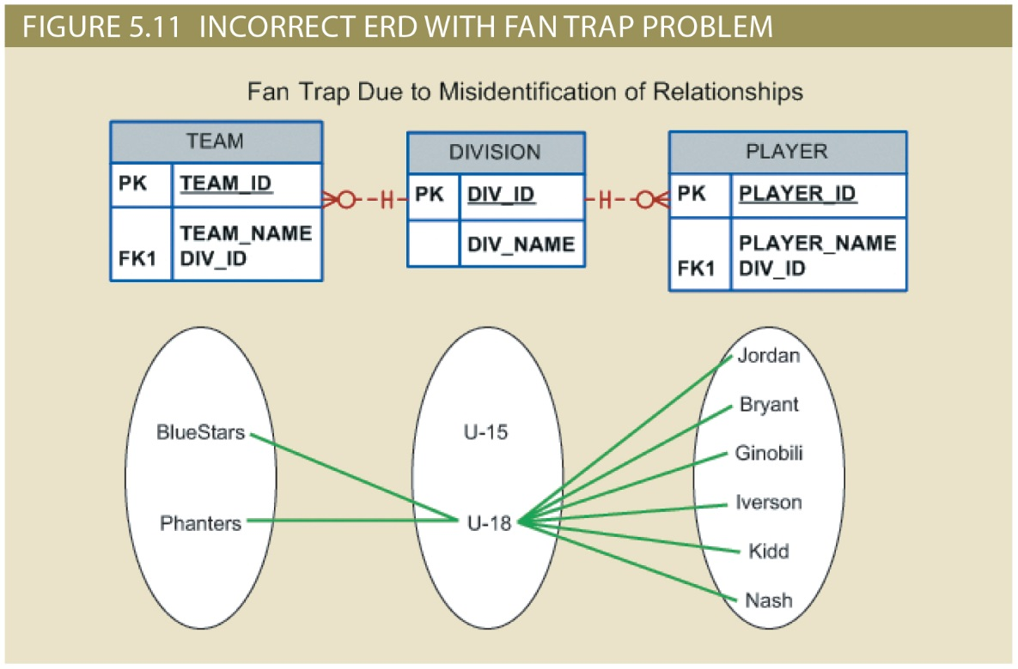
Copyright © 2017 Cengage Learning
17

Slide 18
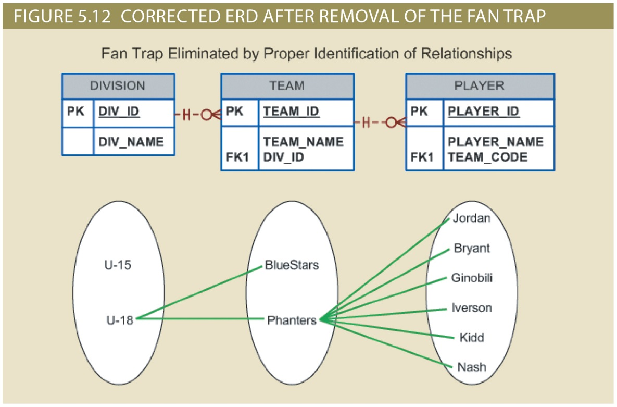
Copyright © 2017 Cengage Learning
18

Slide 19
Design Case 4: Redundant Relationships
Redundancy is seldom a good thing in database environment
Occurs when there are multiple relationship paths between related entities
Main concern is that redundant relationships remain consistent across model
Some designs use redundant relationships to simplify the design and some common queries
Copyright © 2017 Cengage Learning
19

Slide 20
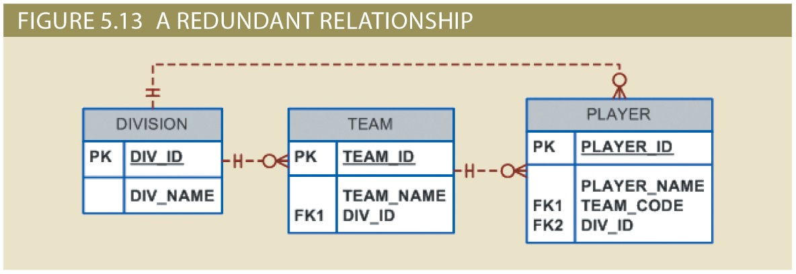
Design Case 4: Redundant Relationships
Copyright © 2017 Cengage Learning
20

Slide 21
Summary
Primary Key Selection is Critical to Success
Time-variant data is common
Data whose values change over time
To maintain history of time-variant data:
Create entity containing the new value, date of change, other time-relevant data
Entity maintains 1:M relationship with entity for which history maintained
Design Trap, e.g., Fan Trap
Redundant relationships occur when multiple relationship paths exist between related entities
Copyright © 2017 Cengage Learning
21

Slide 22
Task
Create an ER diagram that maintains admission history for the tiny college database. You will need a new table that is related to the student table.
Copyright © 2017 Cengage Learning
22

